Slide 1




Group 7
Food Deserts
In
Topeka
Zach Wilson, Mark Messick, Ben Anderson, Annie Di Persio

Slide 2

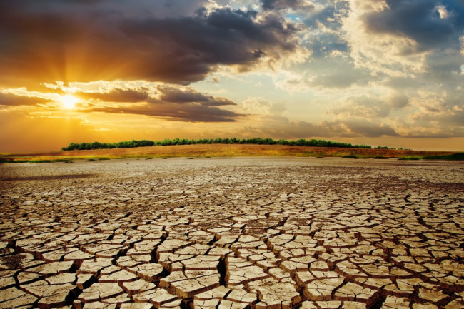
Hypothesis:
If a given area has a higher income, then more grocers are to be found in said area.
Leads to

Slide 3
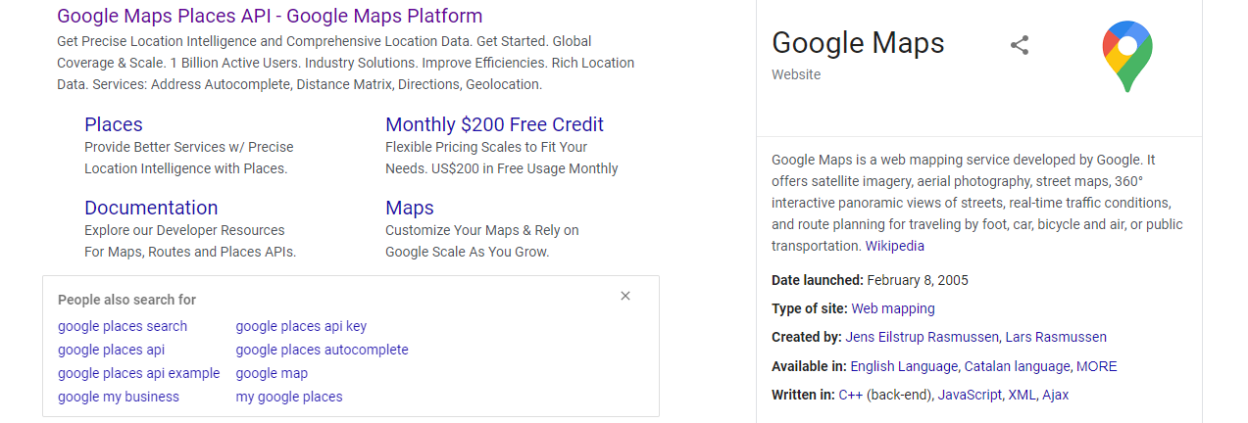
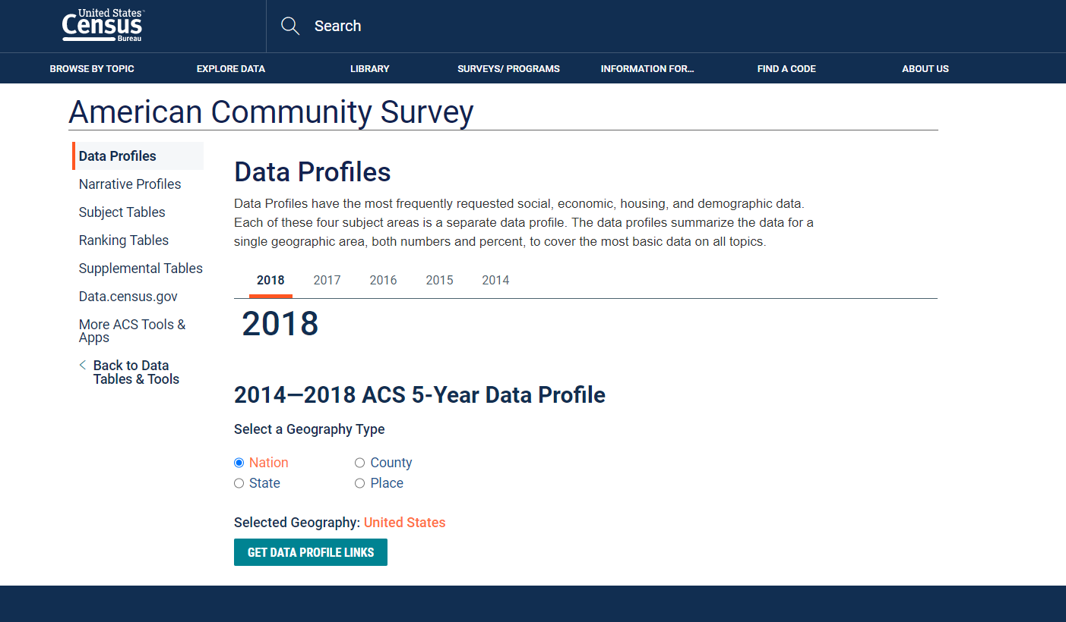
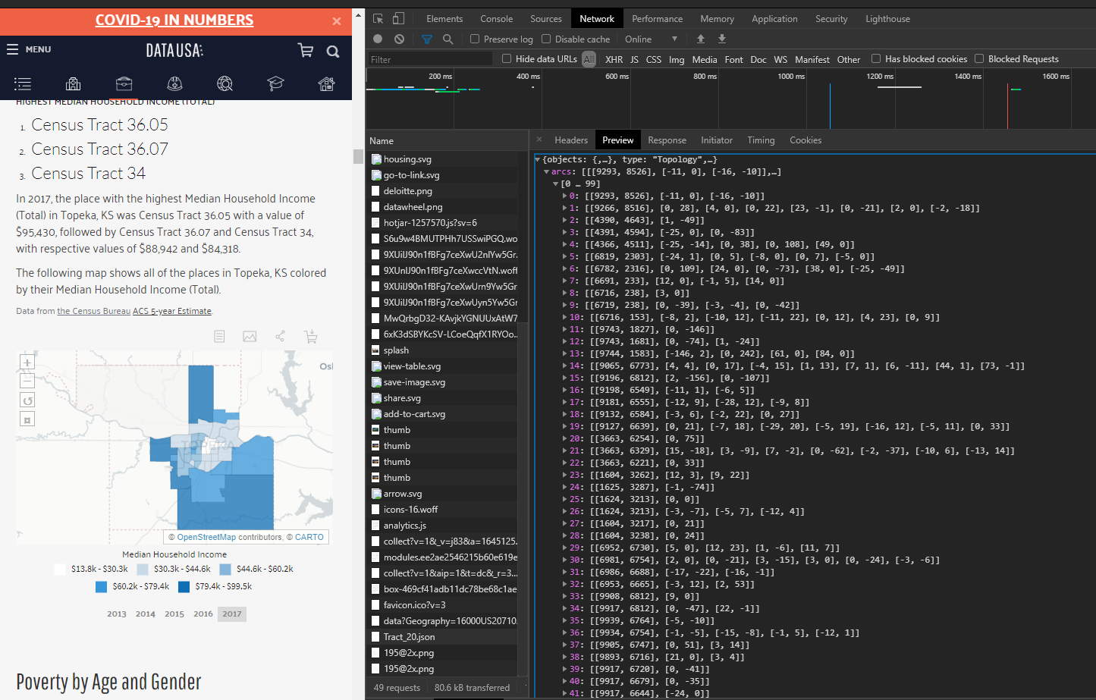
Data Round Up
Google Places Api
Census Bureau American Community Survey
Ben did it so it must be alright
https://www.census.gov/acs/www/data/data-tables-and-tools/data-profiles/
https://datausa.io/profile/geo/topeka-ks/

Slide 4
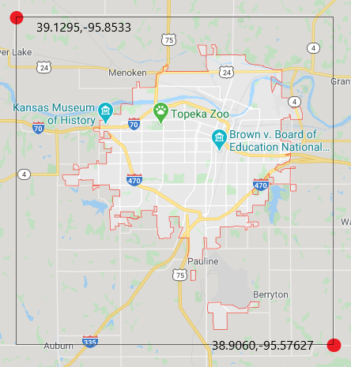
The Area

Slide 5
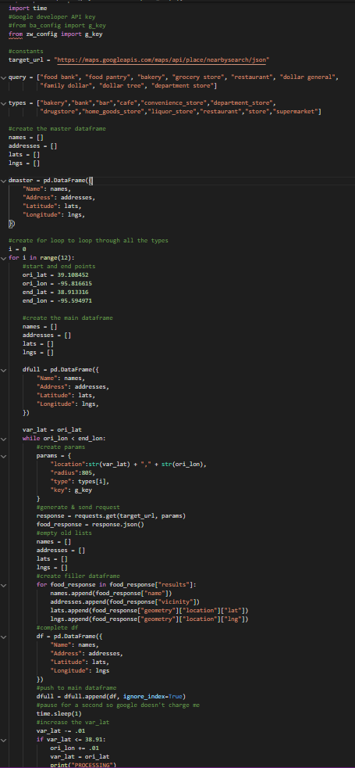

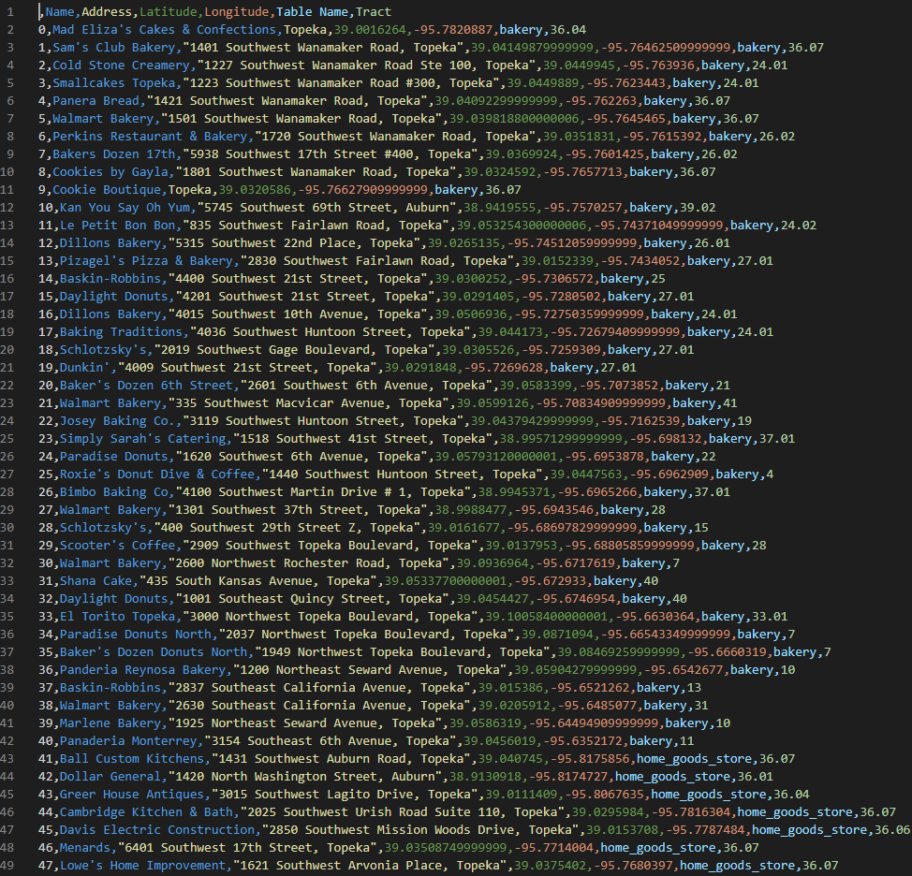
The Data
​The Master
Pulled data from google places Api
The Code
places_scrape.py
clean.py
Master_maker.py
The Product

Slide 6
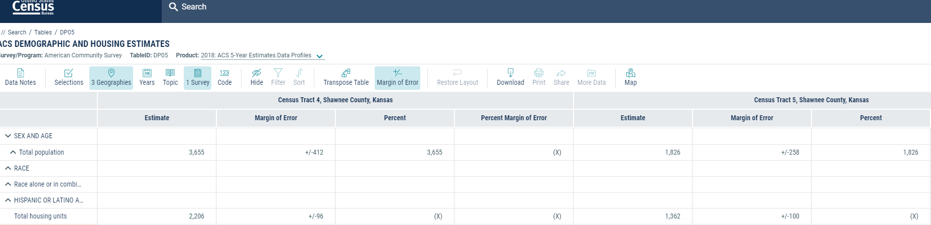
More Data
We also pulled Census Data for the population and housing
https://data.census.gov/cedsci/table?d=ACS%205-Year%20Estimates%20Data%20Profiles&table=DP05&tid=ACSDP5Y2018.DP05&g=0400000US20_1600000US2071000_0500000US20177.140000&hidePreview=true

Slide 7
Tableau stuff
Describe the viz
Cool Viz

Slide 8
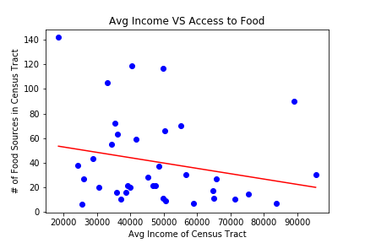
Machine Learning
Using linear regression to look for correlation:
R-Squared: 0.05

Slide 9
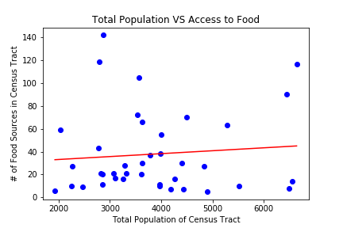
Machine Learning
Looking at other variables:
R-Squared: 0.008

Slide 10
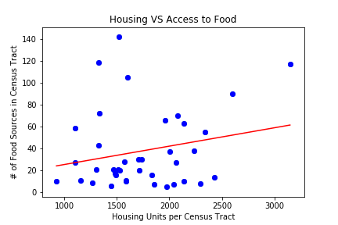
Machine Learning
Looking at other variables:
R-Squared: 0.04

Slide 11
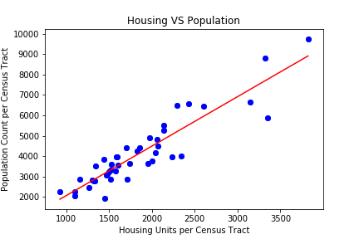
Machine Learning
Quick check to make sure the model is working…
R-Squared: 0.839

Slide 12
Conclusion
Original Hypothesis:
Outcome:
If a given area has a higher income, then more grocers are to be found in said area.
Validation of the null hypothesis.

Slide 13
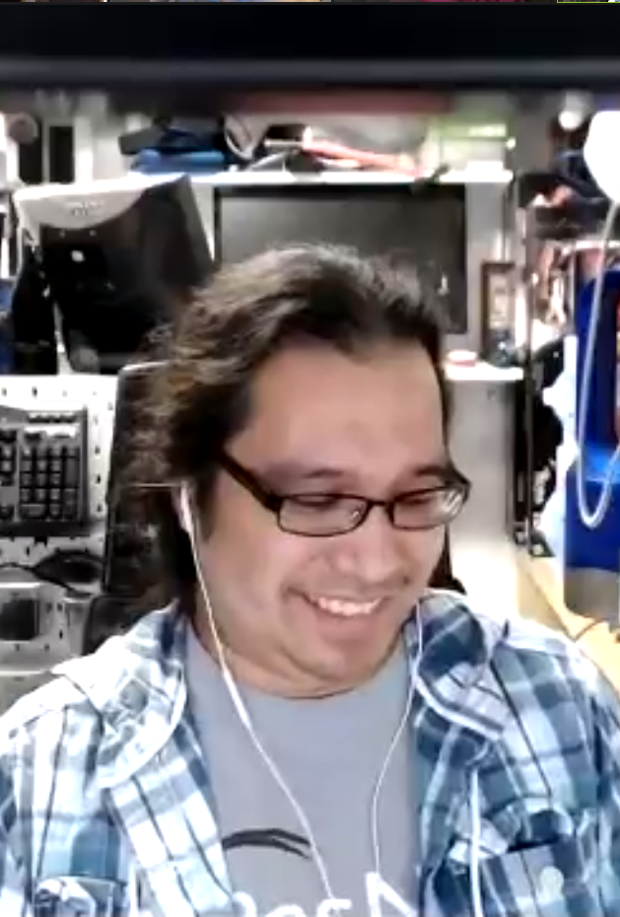
Thanks to the TA'S and to Ben for all the help and support
z

